Slide 1

Game Recommendation system
“ The Gradients”
Team Members:
Abjasree S, Poojan Smart, Niranjan Solanki, Vaishnav Panuganti

Slide 2

Problem Statement
03
01
Evaluation metrics and Models
02
Dataset and EDA
04
Results and Future Scope

Slide 3

Problem Statement
Dataset
Scrape the data necessary for the model and clean it
Build recommendation system for recommending games
Visualizing whether there are any clusters so that we can exploit that property too in building the recommendation system
Data: https://store.steampowered.com/
User Data: https://steamcommunity.com/games/steam/members
We have also obtained the user data from the reviews given for each game

Slide 4
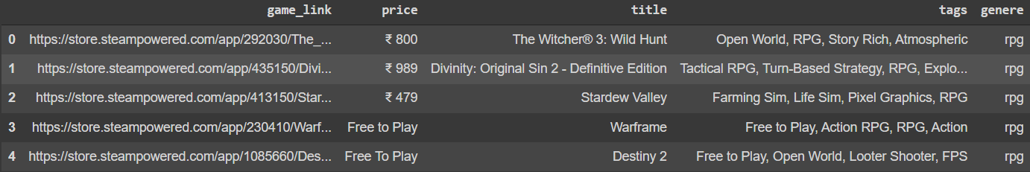
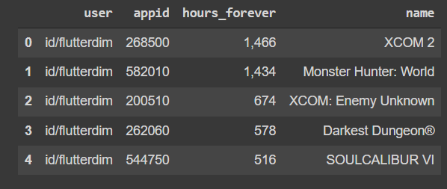
Dataset
Game Dataset
User Dataset
+
The appid is the common feature here and we obtain it by cleaning the url in the game dataset
Hours_forever is used as the implicit feedback and it has either been normalized or rescaled to 0-5

Slide 5
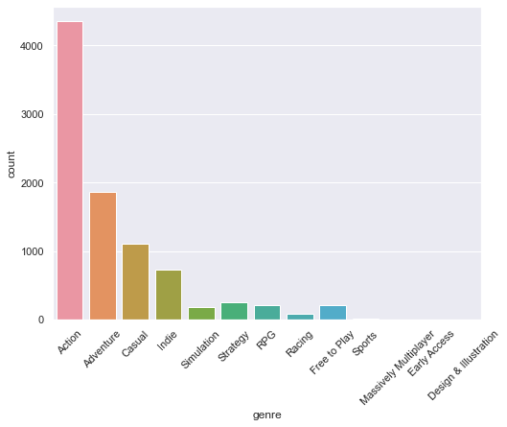
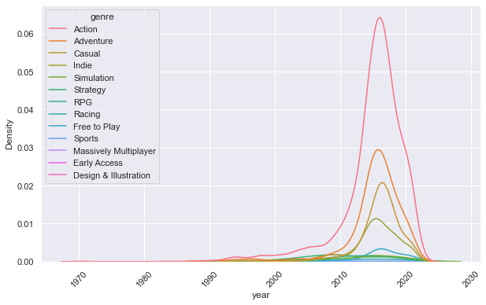
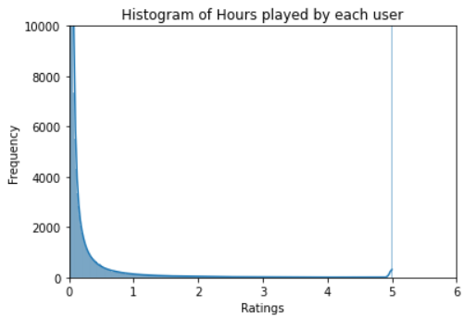
EDA
+
Action most popular genre
No. of games in each genre increased over the years
Most of the values in hours_forever is towards 0

Slide 6
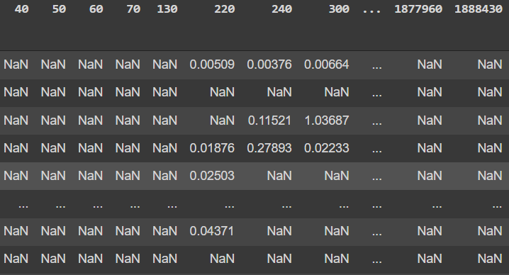
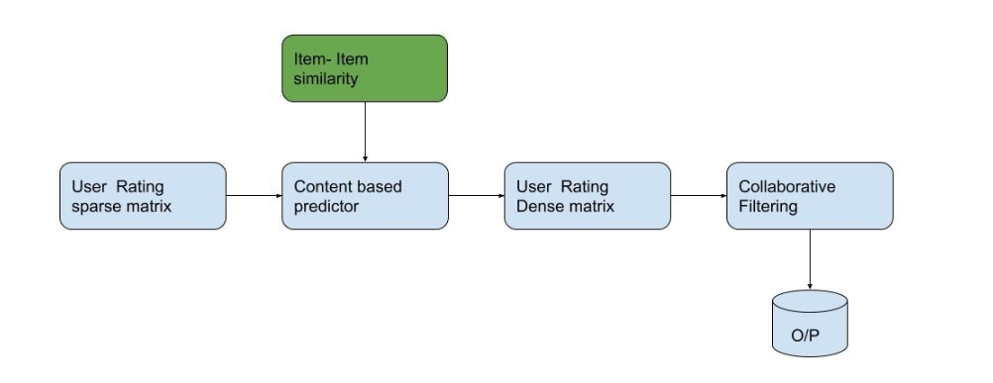
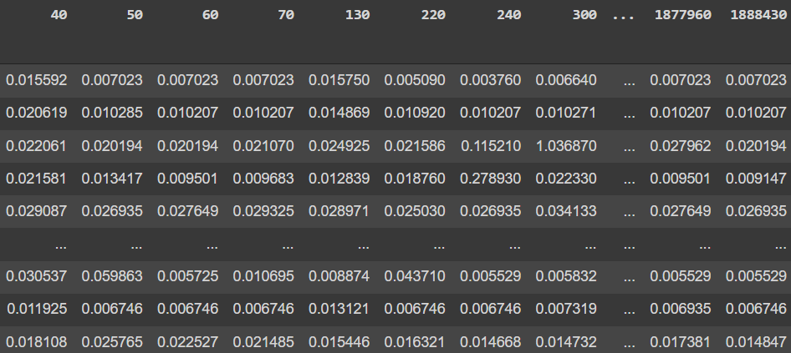
Evaluation metric and Models
Sparse Matrix
Content Boosted Collaborative Filtering
Dense Matrix
Hit-rate: Measure of intersection b/w recommended games and played games
(Ranges from 0 to 1) 0->Bad 1->Good

Slide 7
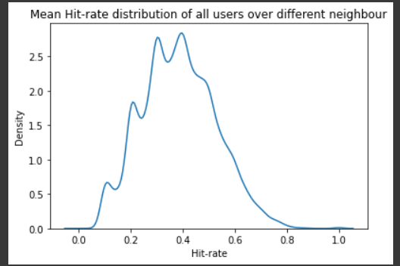
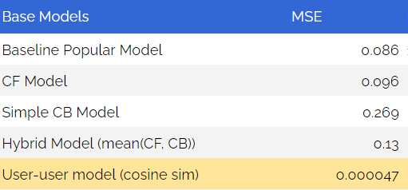
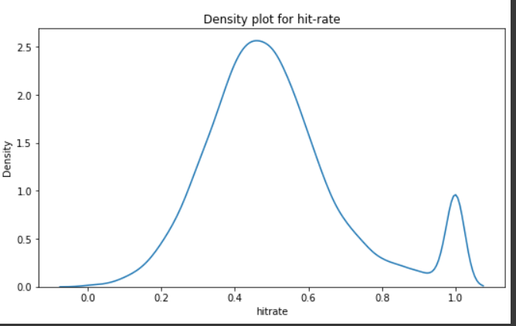
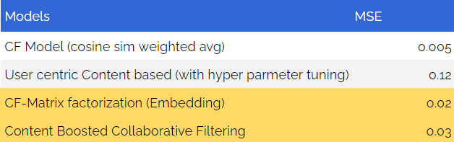
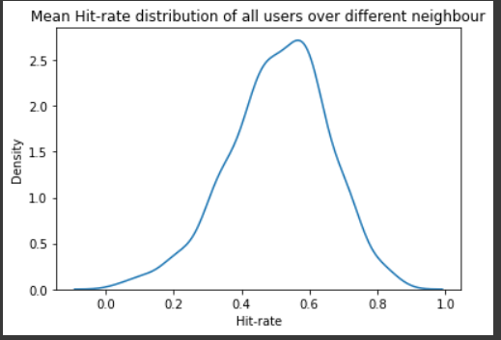
Models and Results
User-user based CF
(Hit-rate distribution)
Matrix factorization
(Hit-rate distribution)
Content-boosted Filtering
(Hit-rate distribution)

Slide 8
Conclusion and Inference
Performance
Eval. Metric
0.51 hit-rate is decent progress but it tells us that we are not able to make models fully personalizable.
MSE can be used as loss function but to interpret results, we can not rely on mse. Hit-rate alone can’t explain the model.
Best Model
Online Evaluation
base model : user-user based filtering (0.41 hit-rate)
complex model: Matrix factorization and content-boosted filtering (0.51 hit-rate)
Our system currently only uses past user’s data, so we haven’t incorporated things like new games released, trends in community etc.

Slide 9
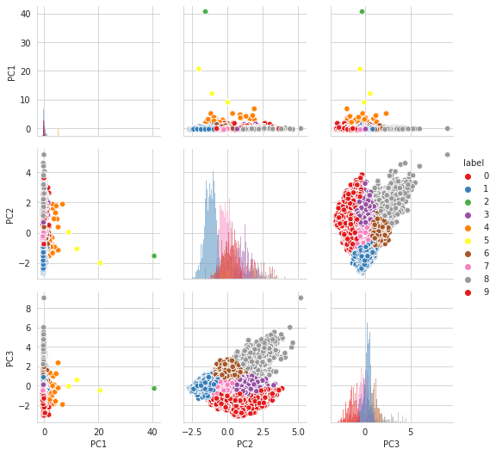
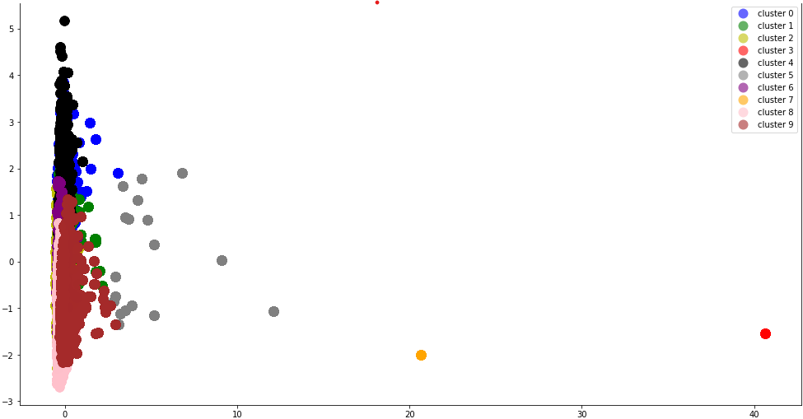
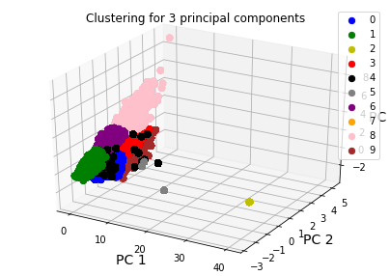
Clustering on Game’s Features
using PCA
PCA n_components = 130 (explains > 90 % variance)
KMeans k = 10 - From edge plot
Can clearly Observe clusters which can be used for further modelling

Slide 10
IMPROVEMENTS
Variety of user’s data
Use other eval. Metrics
We can add variety of users profiles to the dataset. Use steam API to get user’s profile information. Also use other models in content boosted models.
Currently we only used hit-rate to evaluate model performance, we can user ranked hit-rate, novelty etc. metrics.
Game related features
Cluster Based Models
We can find the content based prediction from transformed data exploiting the cluster information and also use other cluster based models
It will be good if we get more game related data like length of the game or story line of the game, since the content boosted filtering when used alone wasn’t giving good results

Slide 11
THANKS!
Team Members
Abjasree S
Poojan Smart
Niranjan Solanki
Vaishnav Panuganti

